Slide 1
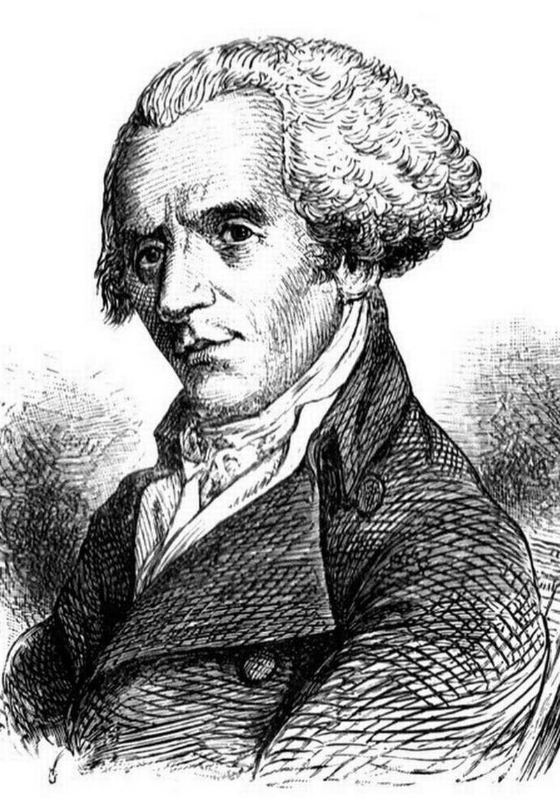
The Case of the Curious Gerrymander: Part II
Experimenting with Redistricting

Slide 2
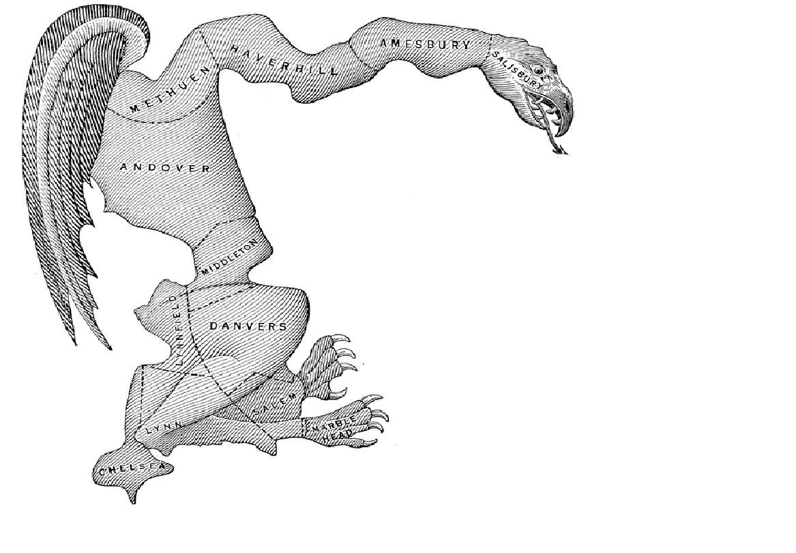

Slide 3
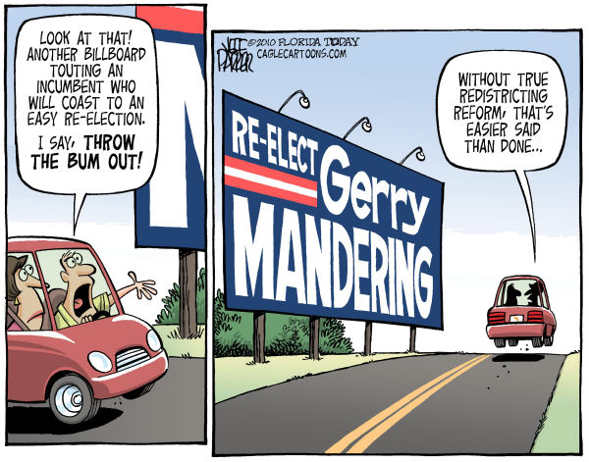

Slide 4
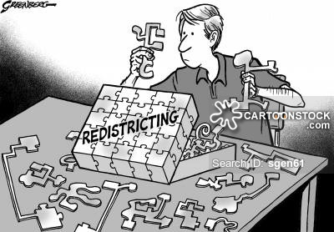

Slide 5
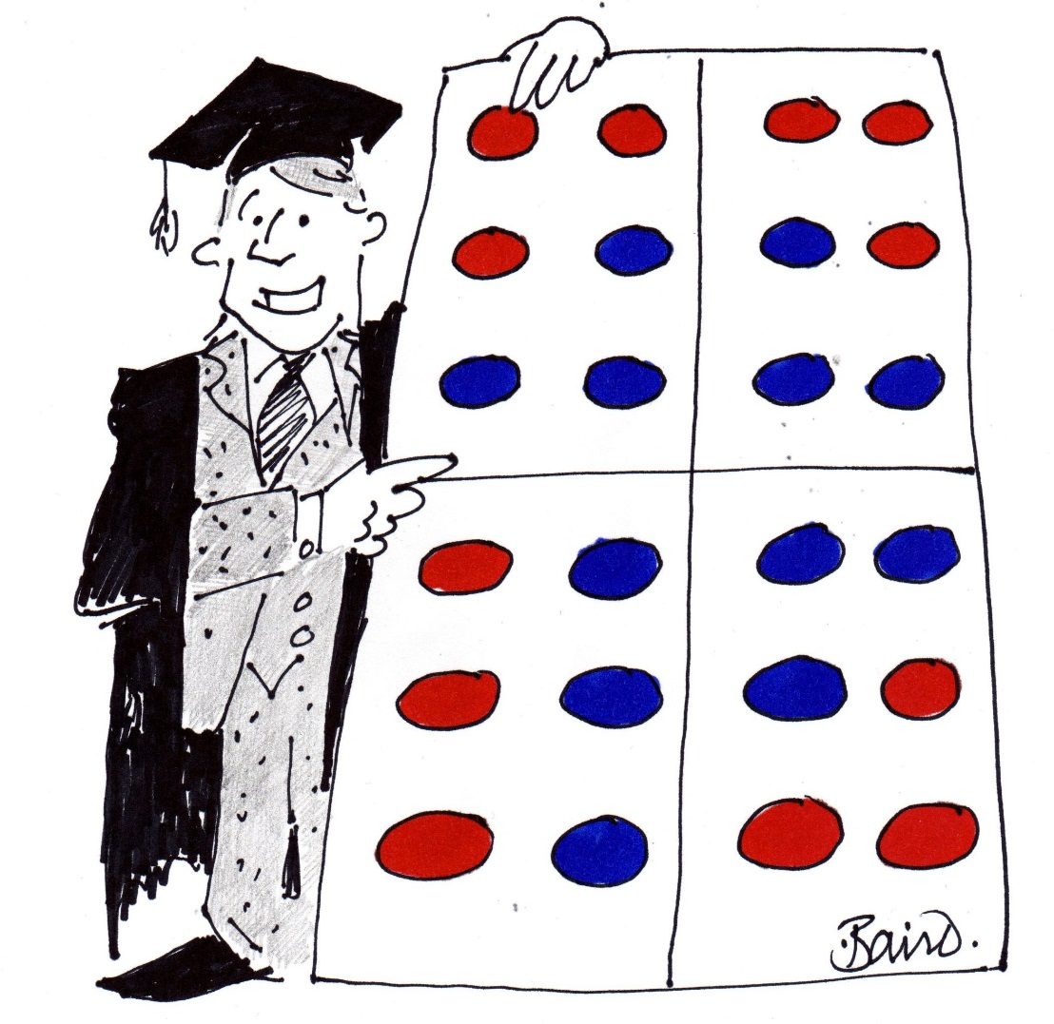
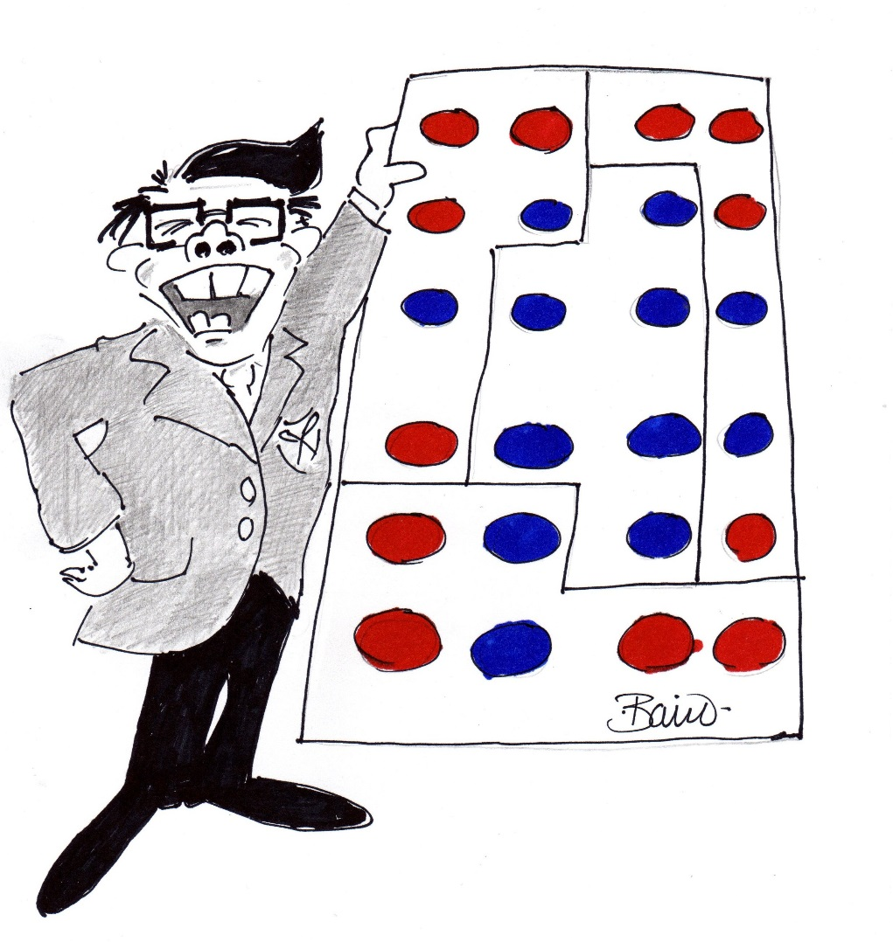

Slide 6
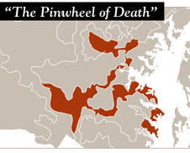
Maryland 3 – One of the Nation’s Top 5 Ugliest Districts
It’s hard to believe Rep. John Sarbanes’ (D) district could get much worse than its present form. But Democrats drew a doozy for Sarbanes by moving parts of Montgomery County into the 3rd district. The district immediately drew comparisons to a Rorschach test for its splotchy shape. One local reporter said it took him nine hours to drive from end to end. So what’s the goal behind giving Sarbanes a district shaped like an amusement park ride? Sources speculate he wants to lay the groundwork for a Senate bid someday, and the pinwheel shape puts him in nearly all of the state’s key media markets.
ROLL CALL
http://www.rollcall.com/features/Election-Preview_2011/election/top-5-ugliest-districts-210224-1.html

Slide 7
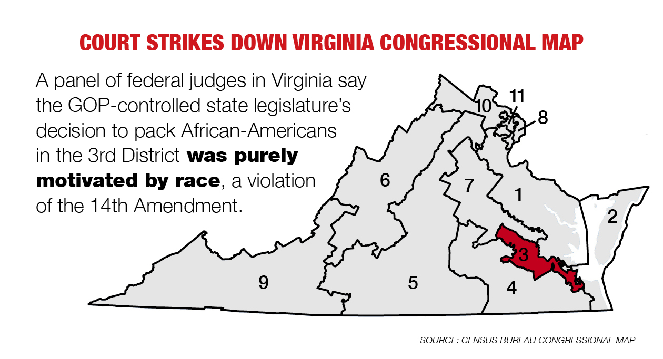

Slide 8
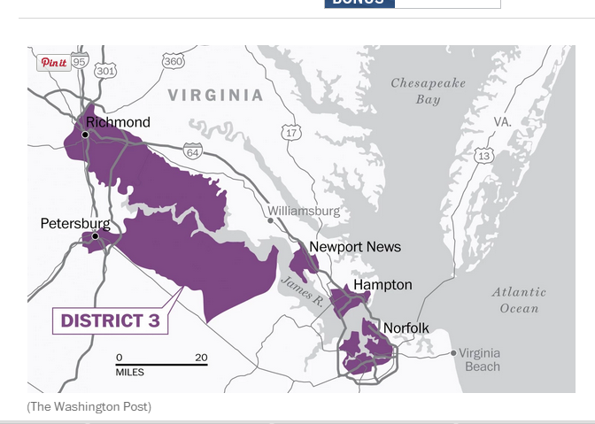

Slide 9
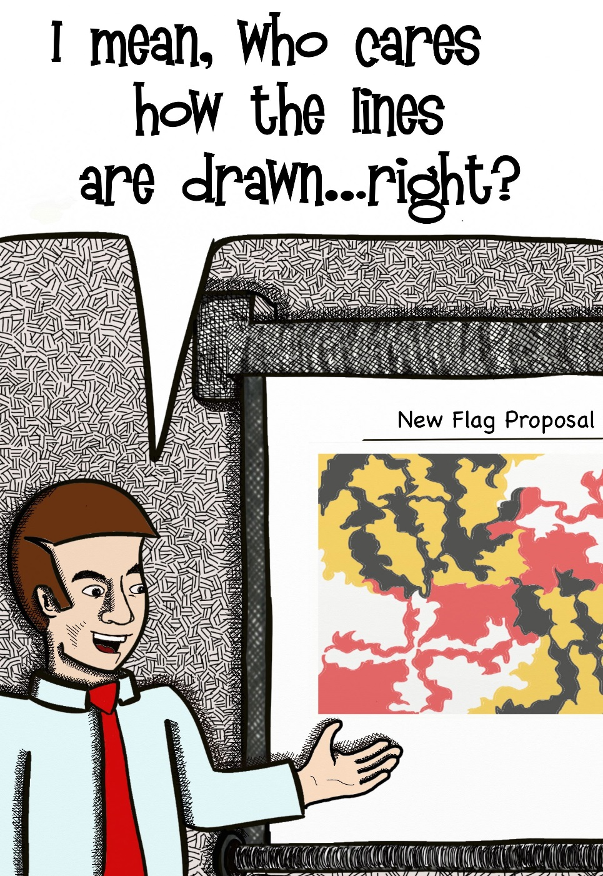
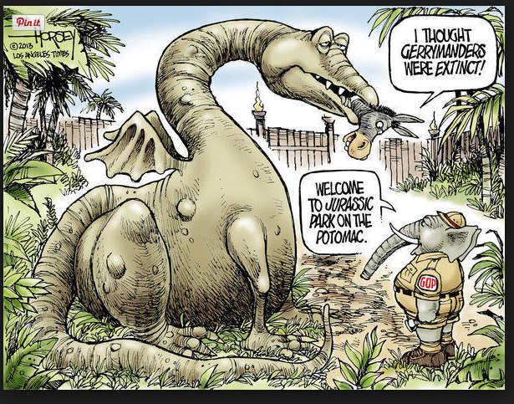

Slide 10
Section 6. Apportionment.
Members of the House of Representatives of the United States and members of the Senate and of the House of Delegates of the General Assembly shall be elected from electoral districts established by the General Assembly. Every electoral district shall be composed of contiguous and compact territory and shall be so constituted as to give, as nearly as is practicable, representation in proportion to the population of the district. The General Assembly shall reapportion the Commonwealth into electoral districts in accordance with this section in the year 2011 and every ten years thereafter.
Any such decennial reapportionment law shall take effect immediately and not be subject to the limitations contained in Article IV, Section 13, of this Constitution.
The districts delineated in the decennial reapportionment law shall be implemented for the November general election for the United States House of Representatives, Senate, or House of Delegates, respectively, that is held immediately prior to the expiration of the term being served in the year that the reapportionment law is required to be enacted. A member in office at the time that a decennial redistricting law is enacted shall complete his term of office and shall continue to represent the district from which he was elected for the duration of such term of office so long as he does not move his residence from the district from which he was elected. Any vacancy occurring during such term shall be filled from the same district that elected the member whose vacancy is being filled.

Slide 11
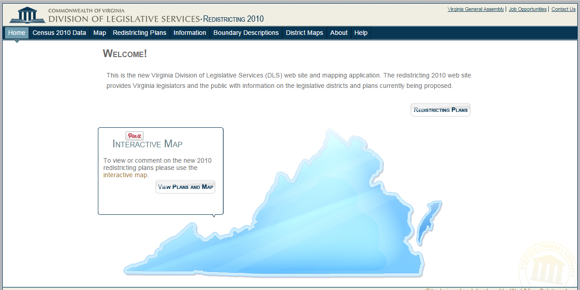
http://redistricting.dls.virginia.gov/2010/
http://www.mdp.state.md.us/Redistricting/redistrictingIMap.shtml
http://www.mdp.state.md.us/Redistricting/redistrictingIMap.shtml

Slide 12

Pushpin Redistricting Game
Students will be tasked with re-districting Franklin.
In Franklin there are 40 Democrats, 40 Republicans and 20 Independents.
Groups will be asked to perform three different scenarios involving re-districting in order to compare and contrast partisanship, non-partisanship and collaborative re-districting.

Slide 13
Round 1:
Every voter in your group is of the same political party. The group needs to:
Create two 3 pin districts
2. Create one four pin district
3. Create One Five pin district
4. CreateOne six pin district
All voters must be in a district!!
The goal is to dominate the elections for your party.
Tally the number of captured voters on the scoresheet for round 1.

Slide 14
Round 2:
People born in January- May= Republicans
People born in June- October= Democrats
People born in November-December= Independents
You will have five minutes to complete this round:
The group must agree on five districts
Each district must contain at least one voter from each party and have at least 20 voters
Goal: To get the most voters in each district for your party. Tally the results on the score sheet.
(If you have no independents- then the two parties control the entire process)

Slide 15

Round 3:
Each person in the group represents a non-partisan official selected to work on the redistricting committee
Must create 5 districts
Work to achieve political party equity
Consider what it best for voters of the state
Tally your responses on the tally sheet.

Slide 16
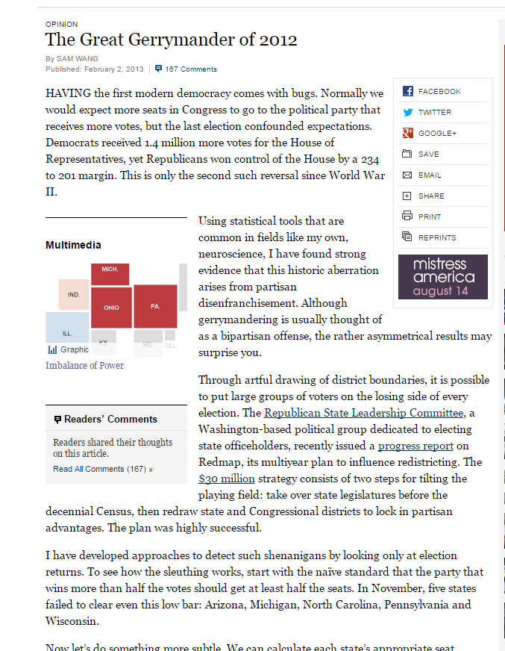
Looking at Gerrymandering on a National Level:
Is gerrymandering a problem?
Why do some states do a better job of creating districts that are more evenly split between the parties?
Do you agree with the author that “gerrymandering is a form of disenfranchisement?”
How would you evaluate the solutions proposed in this editorials? What ideas do you have for correcting the gerrymandering problem?

